Slide 1
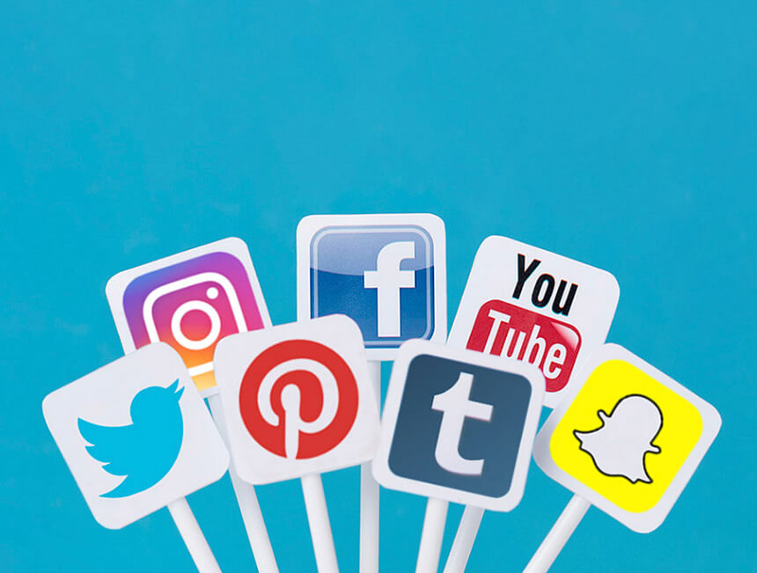
Effective use of Social media; its more than shameless self-promotion!
A Virtual GESSS Webinar
by Dr Verity Normington

Slide 2
I’m not a Sci Comm professional.
I’m sharing information that I have learned from:
-- Workshops such as Superstars of STEM
-- Personal experiences like being the AGCC2018 social media manager
-- Reading studies and articles
-- Observing others who are effective Science Communicators
Always follow your employer's social media policy
Rules for the webinar
-- Live tweet using #VirtualGESSS
-- Polls
-- Use the comments to share your tips
-- Q&A at the end

Slide 3
Poll
Do you use social media for Science Communication?
Yes
No
Not Sure

Slide 4
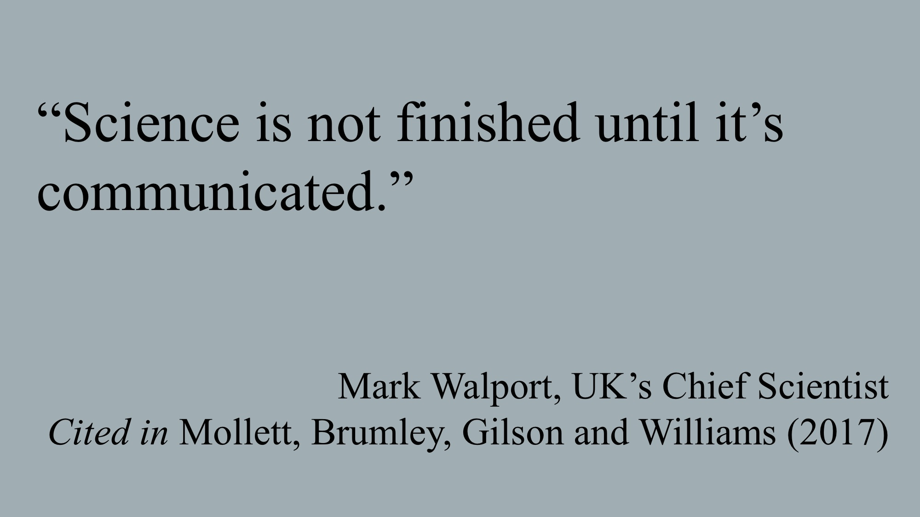
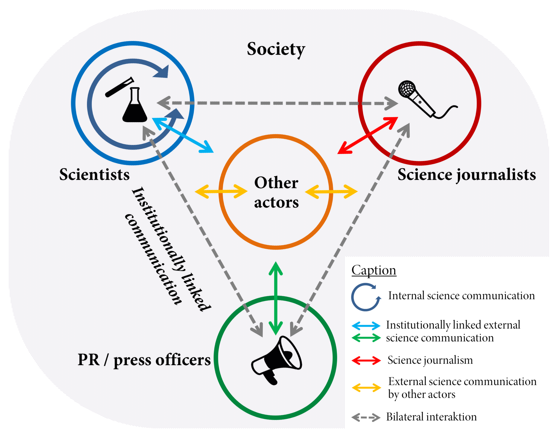
Science Communication
Science communication is the practice of informing, educating, sharing wonderment, and raising awareness of science-related topics.
Science communicators and audiences are ambiguously defined and the expertise and level of science knowledge varies with each group.
Science communicators can use entertainment and persuasion including humour, storytelling and metaphors.
By Spektrumdw - Own work, CC BY-SA 4.0

Slide 5
Poll
Where is your primary source for science news?
Newspaper articles (print and online)
Social media
OpEds eg The Conversation, Newspapers
Scientific Journals
TV news
Internet

Slide 6
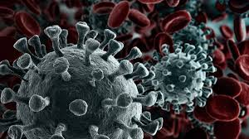
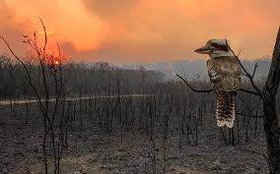
Why Science Communication?
“When scientists are able to communicate effectively beyond their peers to broader, non-scientist audiences, it builds support for science, promotes understanding of its wider relevance to society, and encourages more informed decision-making at all levels, from government to communities to individuals. It can also make science accessible to audiences that traditionally have been excluded from the process of science. It can help make science more diverse and inclusive.”
Dr Monica Feliu-Mojer, Director of Communications and Science Outreach, Ciencia Puerto Rico

Slide 7
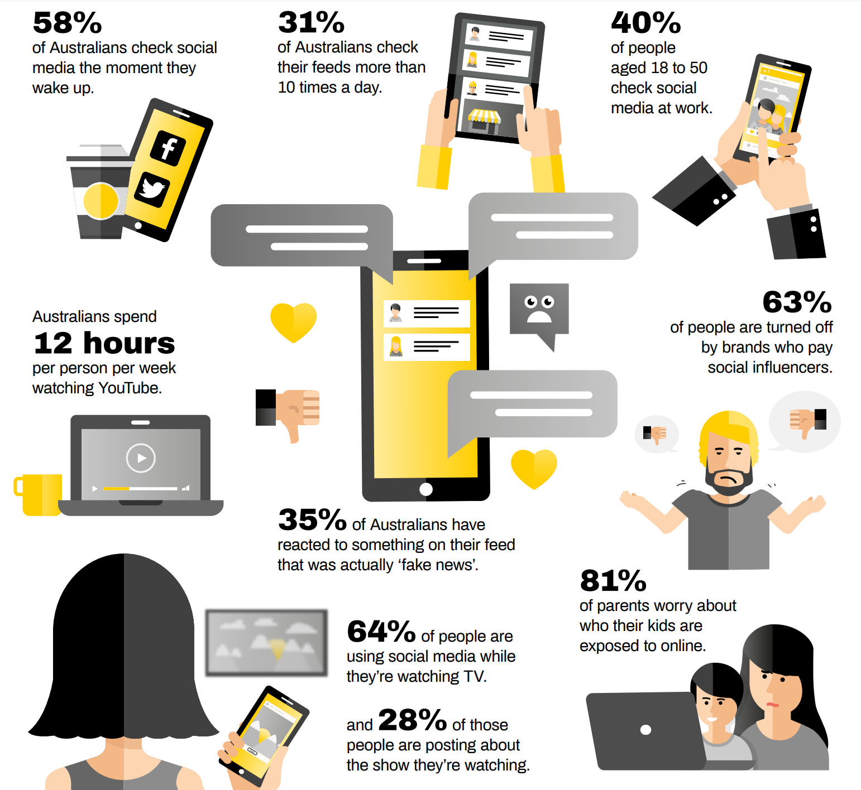
Why Social Media? It’s in the numbers
79% use social media
31% check socials more than 10 times a day
And as scientists this is particularly concerning
35% have reacted to something that was actually fake news
https://2k5zke3drtv7fuwec1mzuxgv-wpengine.netdna-ssl.com/wp-content/uploads/2020/07/Yellow-Social-Media-Report-2020-Consumer-Fun-Facts.pdf

Slide 8
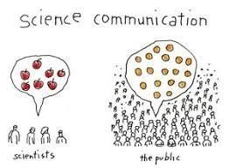
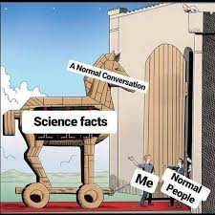
Why science communication via social media?
It allows you to
Create your own online presence that you can manage, on your terms
Build relationships and connect with peers, other researchers, potential employees and the interested public
Keep people up to date with your research or news in your field of science, and allow them to offer their comments, support and ideas
Inspire others to become interested and involved in science
Source, share and securely archive content that interests you

Slide 9
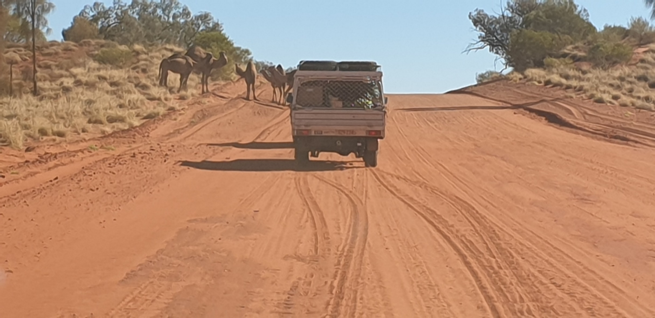
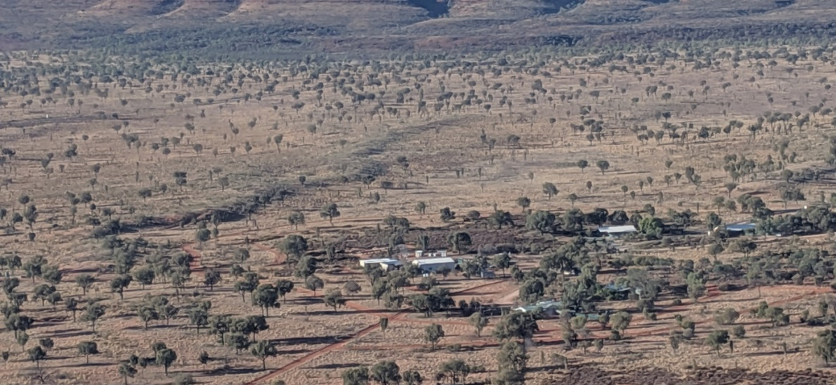
But I don’t have anything to say
Share
Your science and research
Just don’t spoil the publishable results
Build
Your professional profile
Your employers profile
Interest in your research
Pre-interest for your publication
Interest for your event/presentation/webinar/ society
Reshare
Interesting articles
Colleague’s posts
Interact
Respond to comments
Comment on others posts

Slide 10
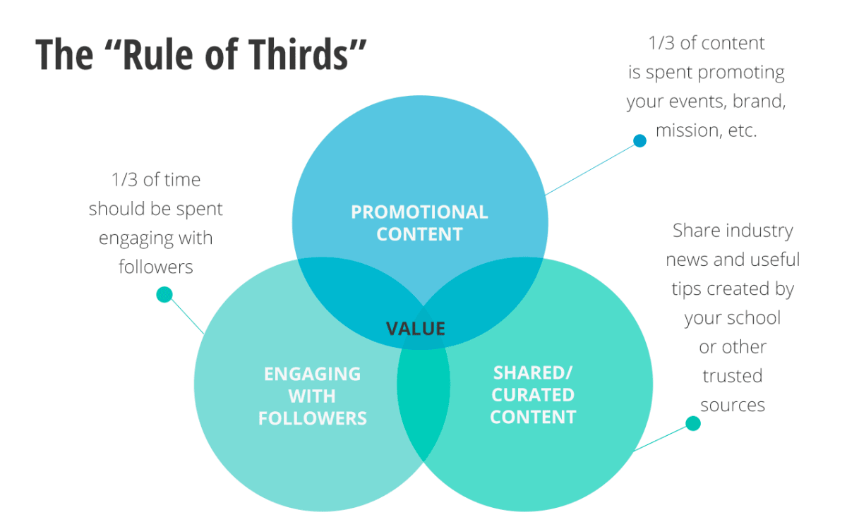
Balanced
content

Slide 11
Who do you want to be online?

Slide 12
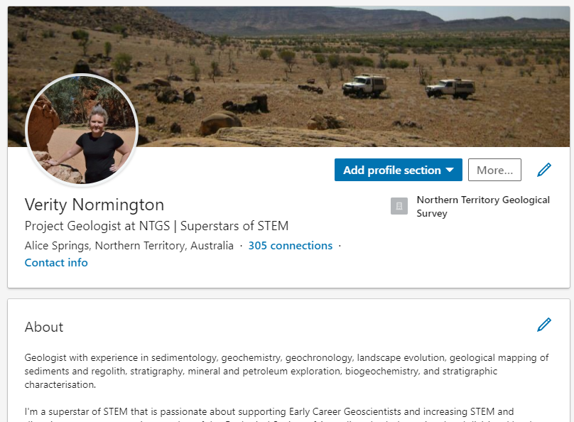
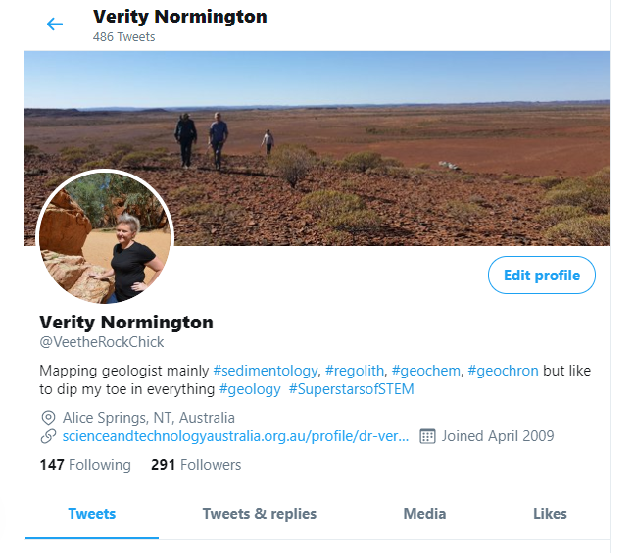
Know your brand and message
LinkedIn
Knowing who you want to be means you can start to build your brand and the message(s) you want to tell
Adapt your posts based on the audience and platform
Tailor your posts to suit your brand and message and the platform posting to
Use language that everyone will understand
Instead of ‘isotopic dating’ or ‘geochronology’ use ‘age dating’
Twitter: @VeetheRockChick

Slide 13
A hashtag is a label for content.
It helps others who are interested in a certain topic, quickly find content on that same topic
Use them to join the conversation
Tip: to make #Hashtags readable by screenreading software for the hearing impaired Capitalise each word
#GeologicalSocietyOfAustralia
Make them unique – do a search first
Make them easy to understand and remember
Limit hashtag to 3 or 4

Slide 14
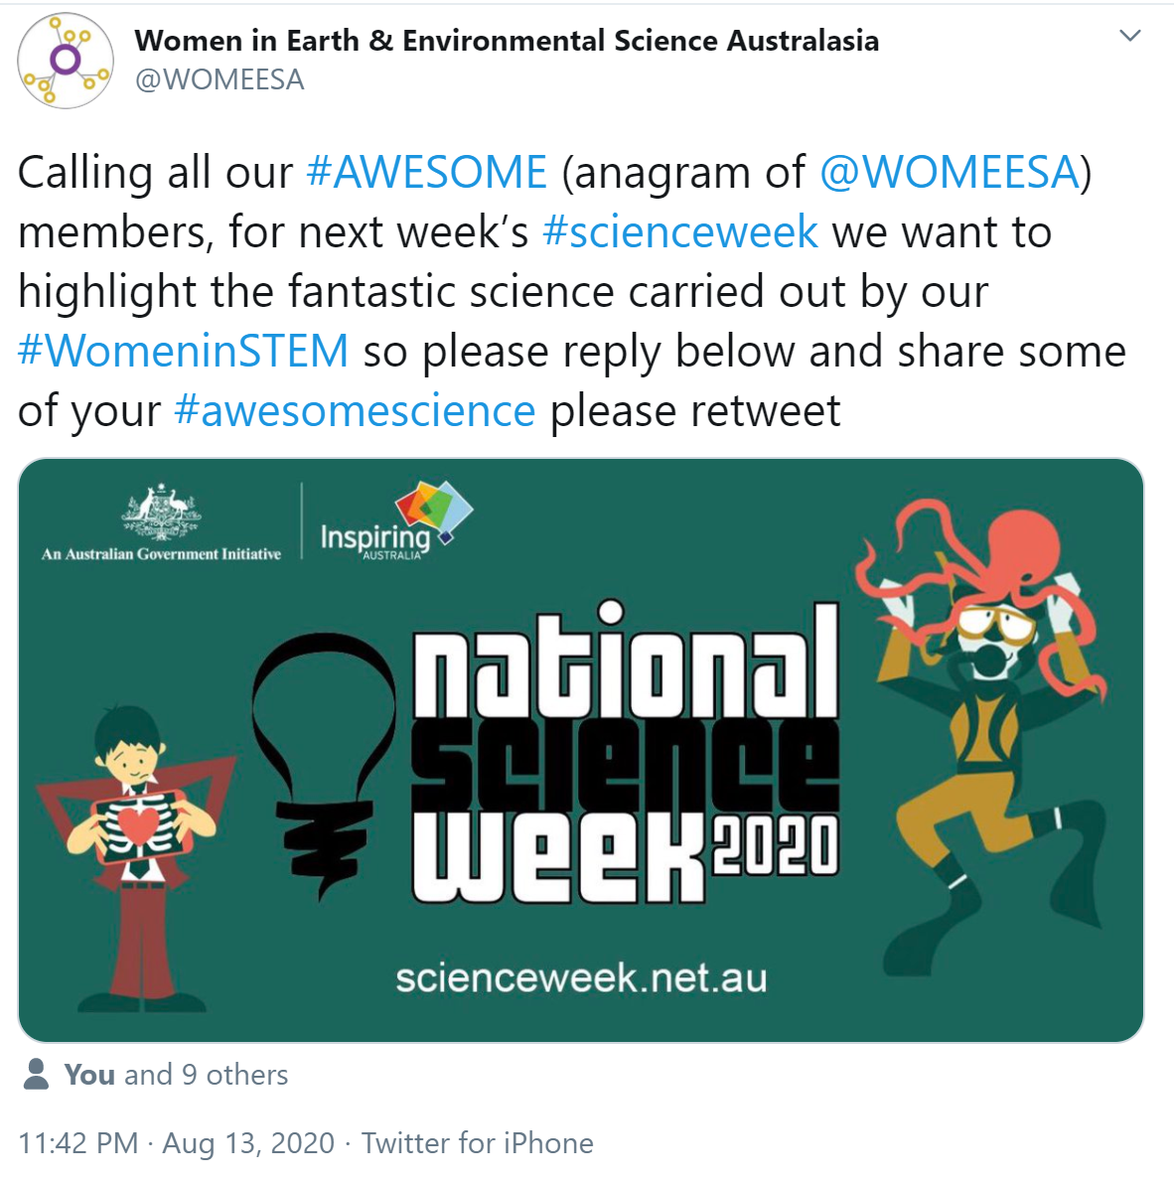
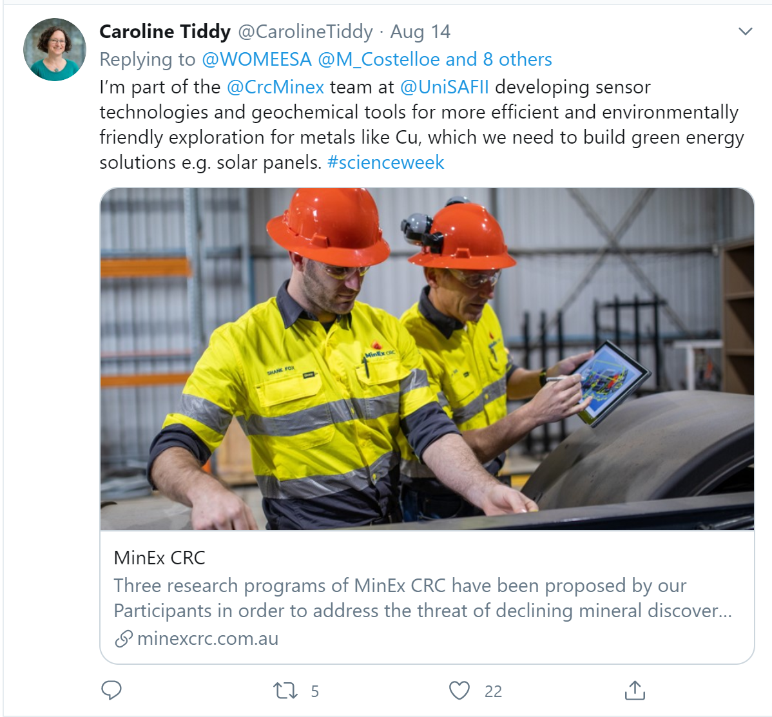
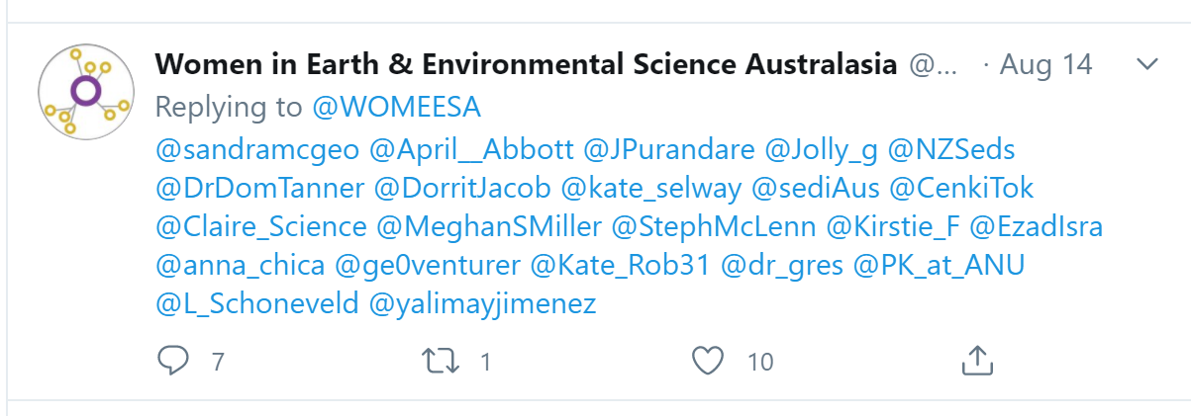
Tagging
is when someone mentions you in a post and there is a link to your profile that others can click on
Use this when you want to draw people’s attention to someone within your post or comment
Typically using ‘@name’ will tag and link the person
This is a great way to interact and give a shout out to someone you want to connect with
Tip: On twitter don’t start a tweet with a tag use .@name to make sure it works

Slide 15
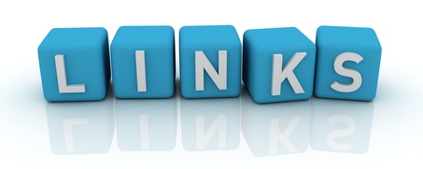
TIP: Sites like bit.ly and tinyurl.com let you create shorter links for free
Links imbedded in your posts are important to direct your followers to more information or to download a publications
Most platforms let you just copy and paste links into posts and it will hyperlink it automatically
Twitter where you are limited to 140 characters use smaller urls
Instagram doesn’t hyperlink – put the link in your bio, just remember to say that its there

Slide 16
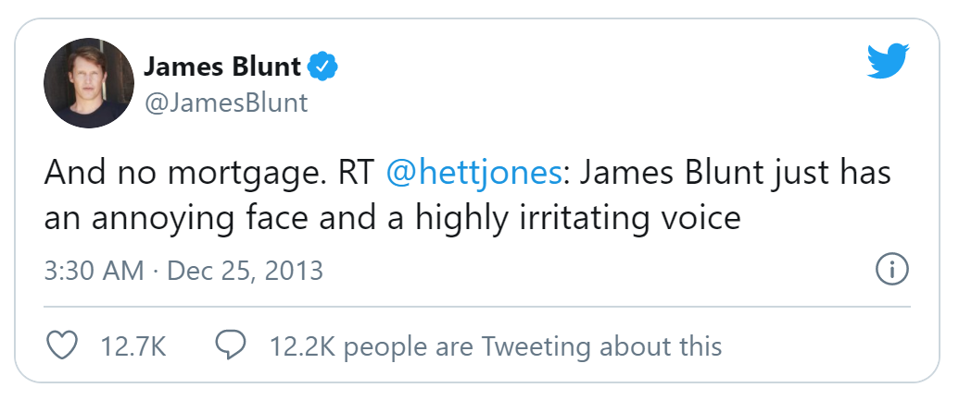
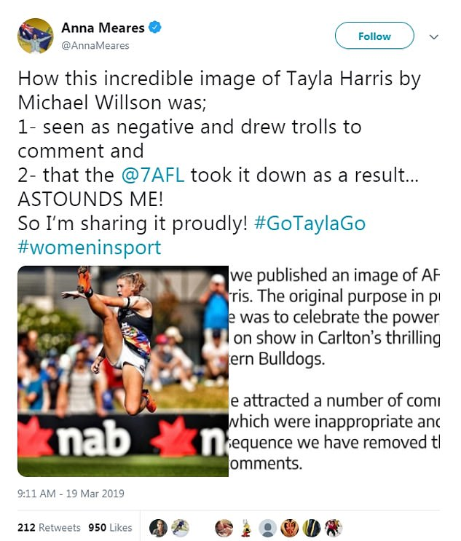
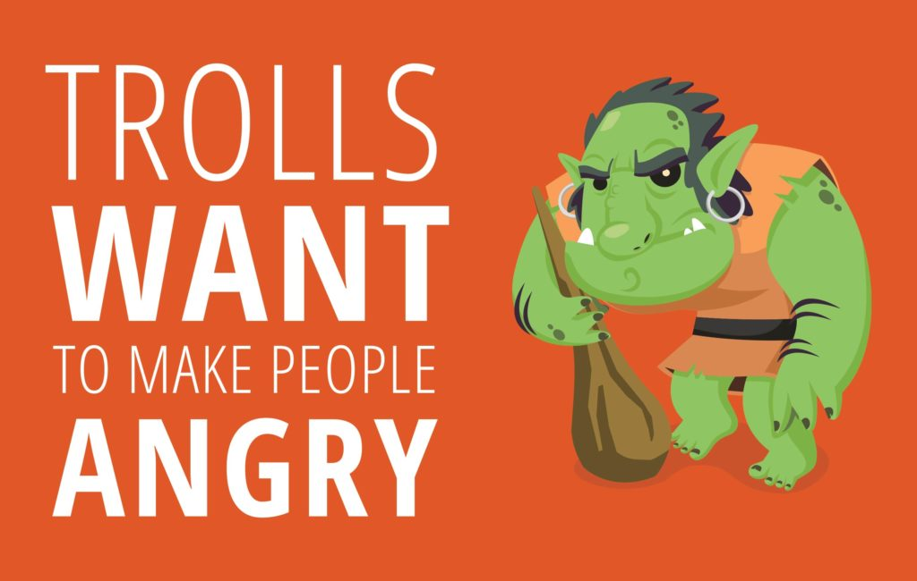
Ignore the Trolls
Diffuse with Humour
Block or Ban and Report – keep them in the Dungeon
Don’t be baited
Don’t delete their posts
Build supportive, friendly community

Slide 17
Poll
What social media platforms do you use (sci-comm and other)
Facebook
Instagram
Twitter
Linkedin
Tictoc
Snapchat
Youtube
Other

Slide 18
is a social networking site where people share their lives, their interests and their holiday snaps with their Facebook ‘friends’. Since the line between professional and social life is not a clear one, Facebook, used with care, can be a great way to stay in touch with research colleagues from all over the world.
Advantages
Most popular platform
Huge potential audience
Great driver of traffic to websites
Highly targeted
Usage in Australia (2019 stats)
15,000,000 users
88% male, 94% female
35-39 year olds are highest daily users
Facebook is used 16 minutes per use
NT and Tas use most frequently, Vic use least frequestly

Slide 19
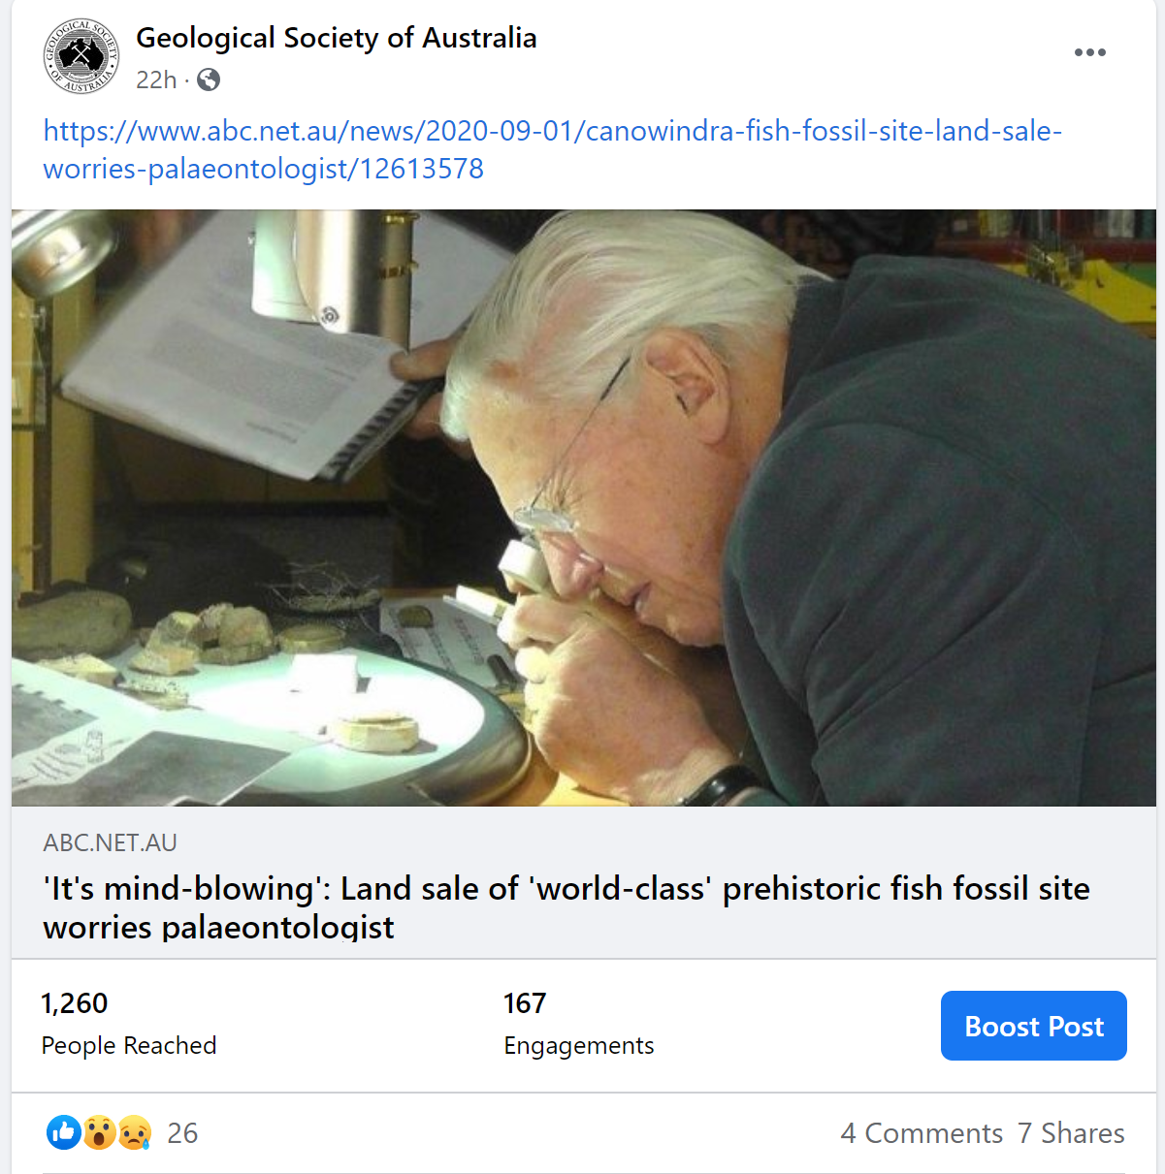
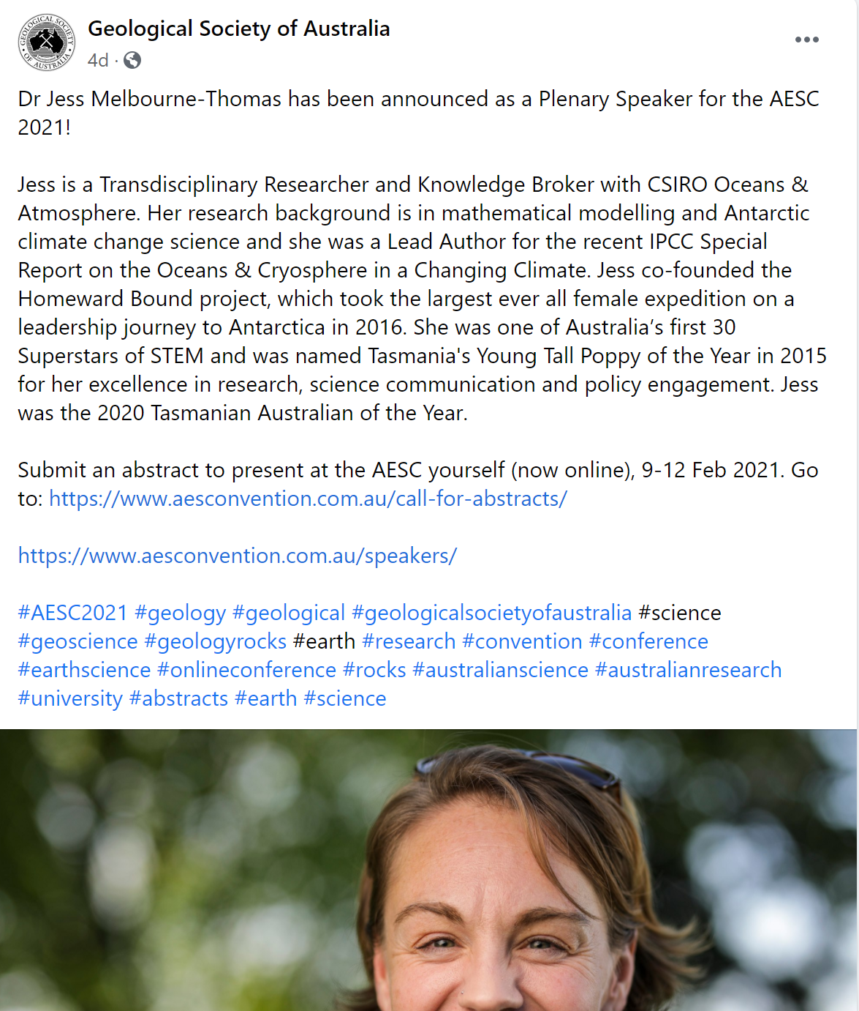
Using it effectively
Post regularly – 3-4 times a week as a start – no more than 1 post a day
Inject personality – a human voice makes you relatable
Ask questions to encourage interaction
Aim to spend about 1.5-2 hours a week posting, retweeting and interacting

Slide 20
is an ongoing public conversation where people all over the world can post short messages which are picked up and responded to by others.
Advantages
Huge potential audience
No restriction on post frequency
Highly interactive
Easy to connect with influencers
Easy use of #hashtags
Broader media commonly use it
Easy to track success of tweets
Usage in Australia (2019 stats)
4,700,000 users
26% male, 13% female
30-39 year olds - largest age demographic (25%)
8% of users just read and don’t tweet at all
Notes:
Twitter is a fast and brief form of staying in touch. You can check Twitter in your spare moments to see what like-minded people are talking about.

Slide 21
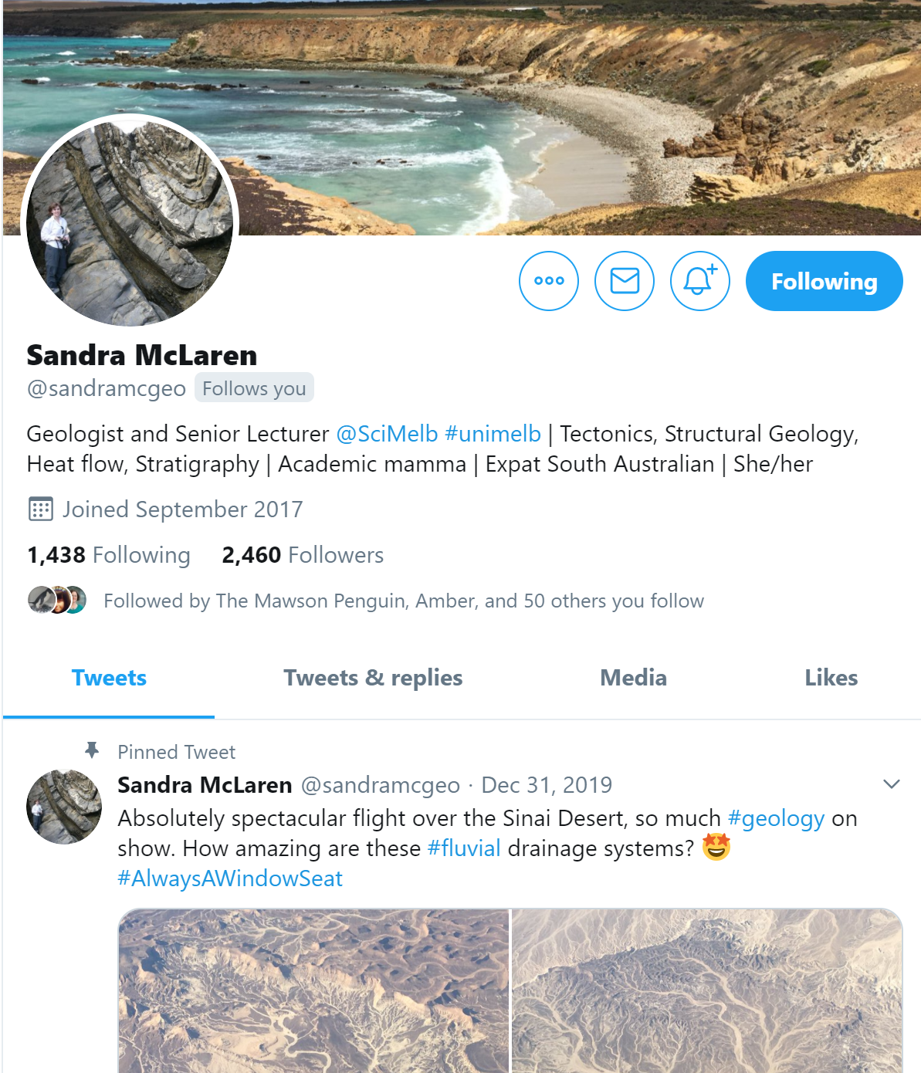
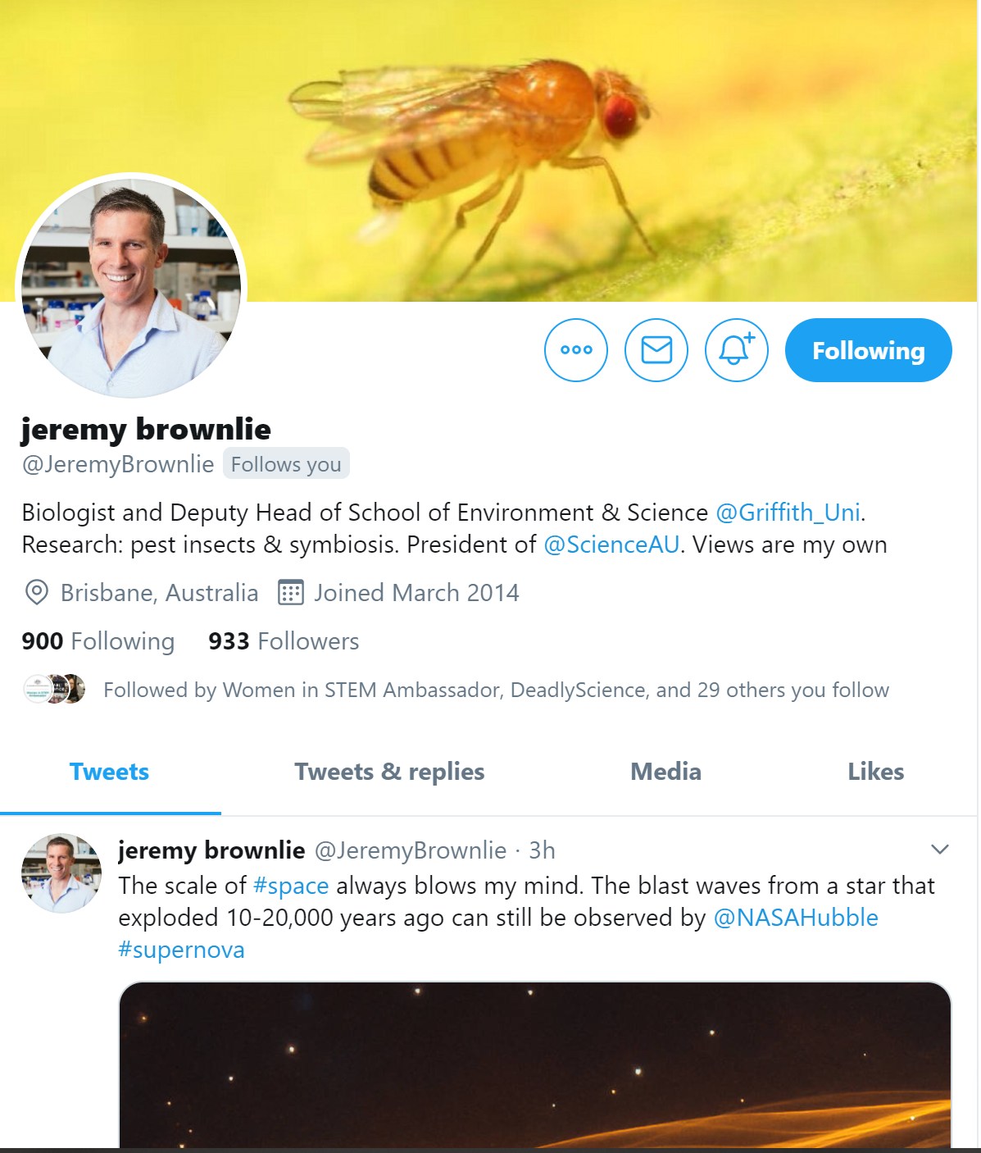
Using it effectively
Follow others to gain followers
Post regularly – at least once a day
Use #hashtags to tap into trending conversations
Engage with people using @ to reply and thank
Show an interest – ask questions
Promote other people’s content
Aim to spend about 90 minutes a week posting, retweeting and interacting

Slide 22
allows you to apply filters and location data to photos and share them on other social media sites like Facebook and Twitter.
Advantages
Largely visual platform
Useful for scientists working in the field
Popular with younger demographics
Instagram stories – real-time content
It’s about you and your work, not just your work
Usage in Australia (2019 stats)
9,000,000 users
34% male, 44% female
18-29 year olds largest age demographic (66%)
30-39 year olds close 2nd at 53%
Victorians are on average the highest users followed by NSW, SA ranks the lowest

Slide 23
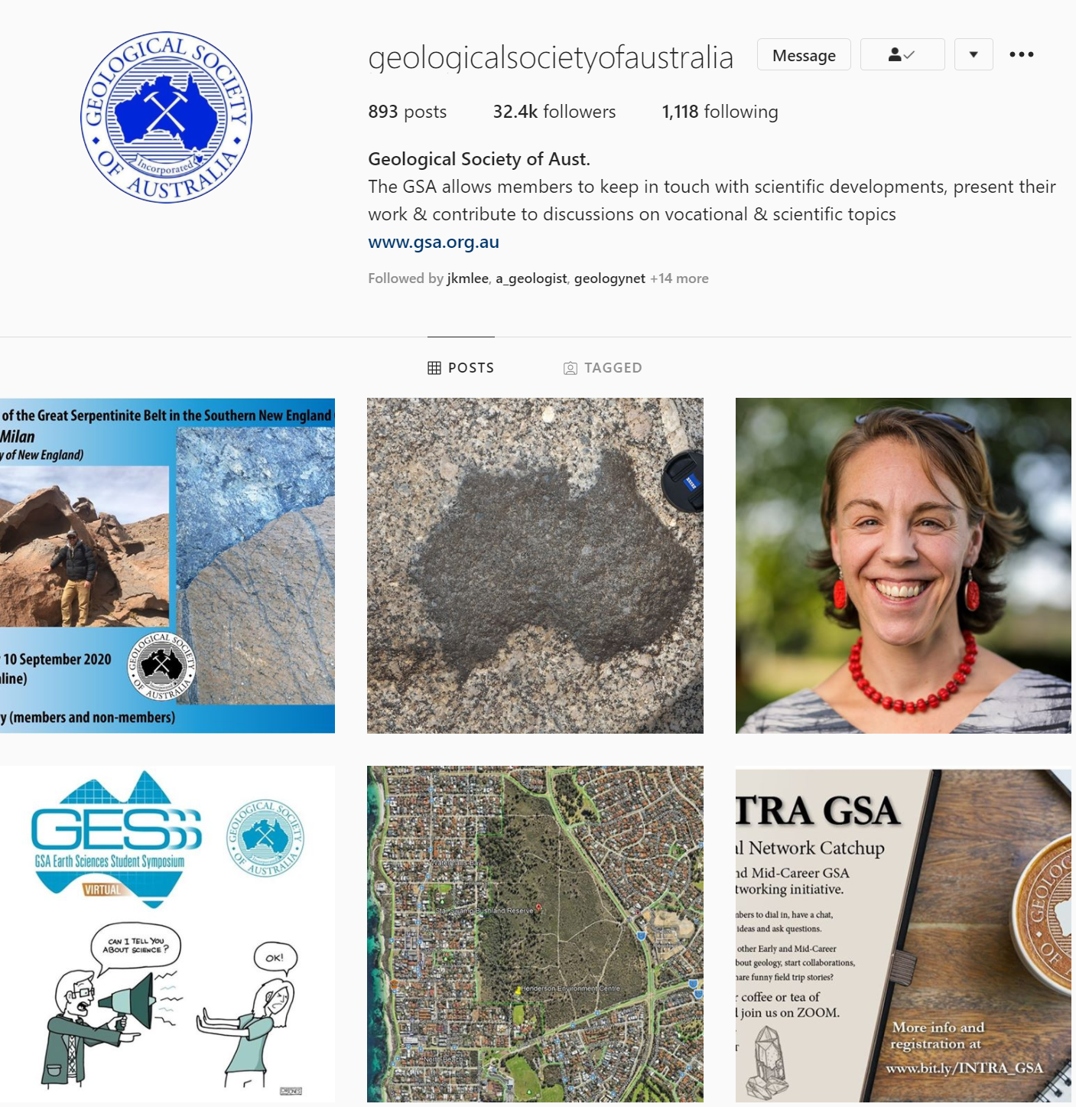
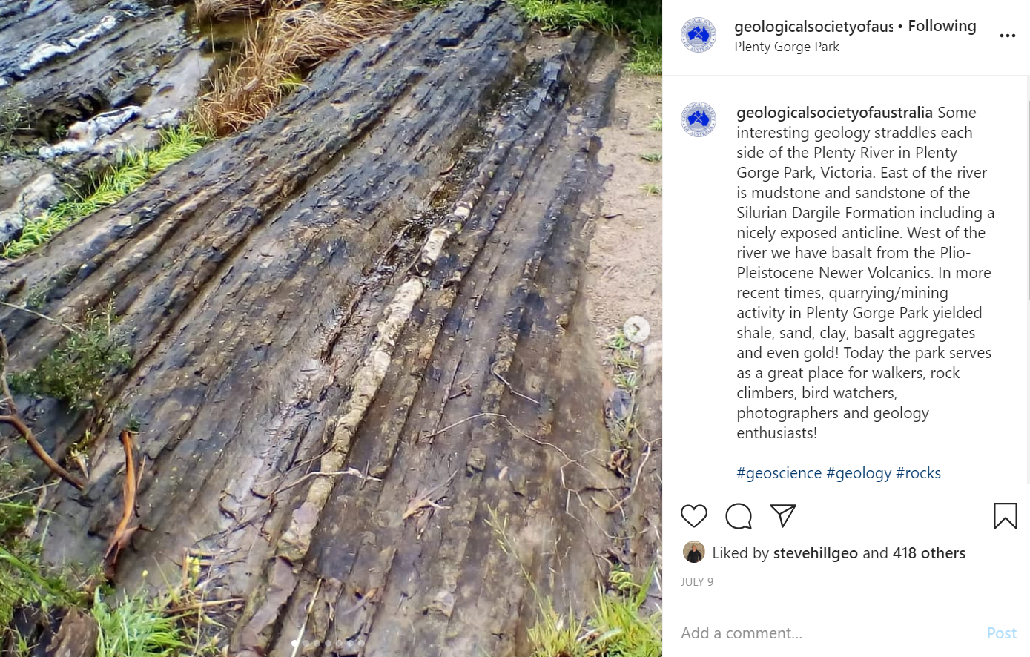
Using it effectively
Follow and interact with others to gain followers
Post regularly – at least 3 times a week
Post a variety of content
Like and comment on pictures you find interesting
Aim to spend about 60 minutes a week posting, retweeting and interacting

Slide 24
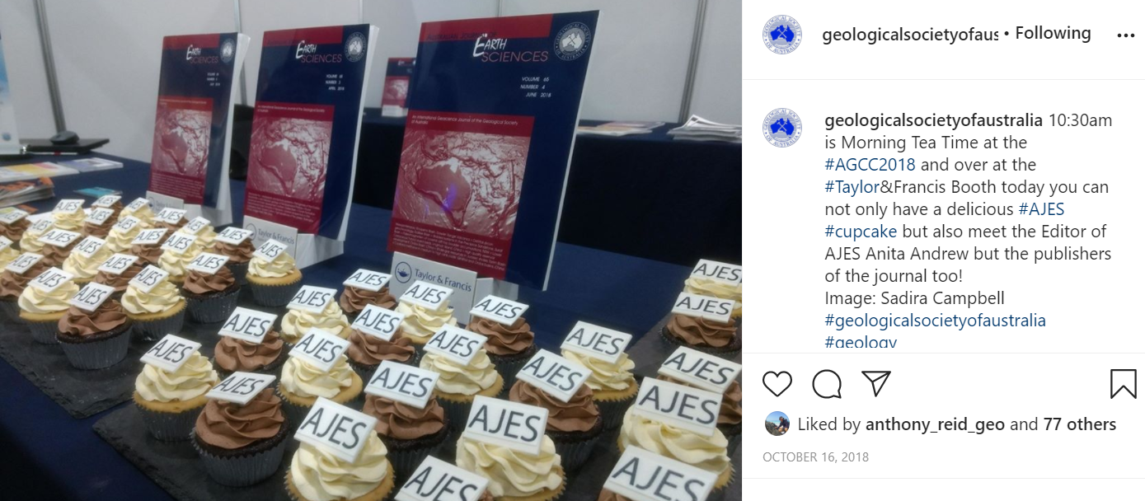
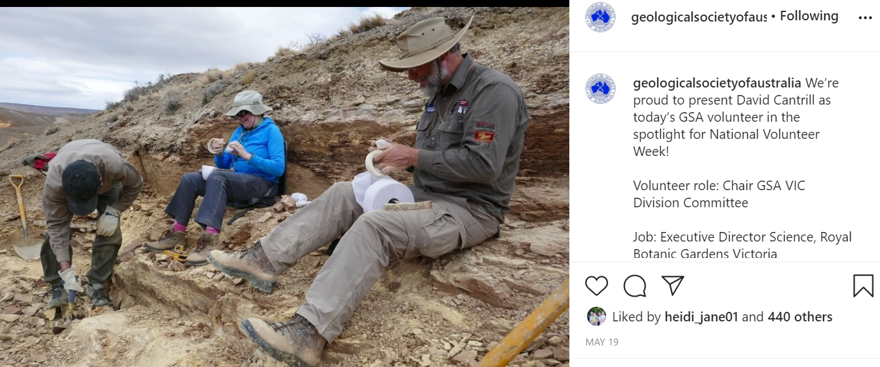
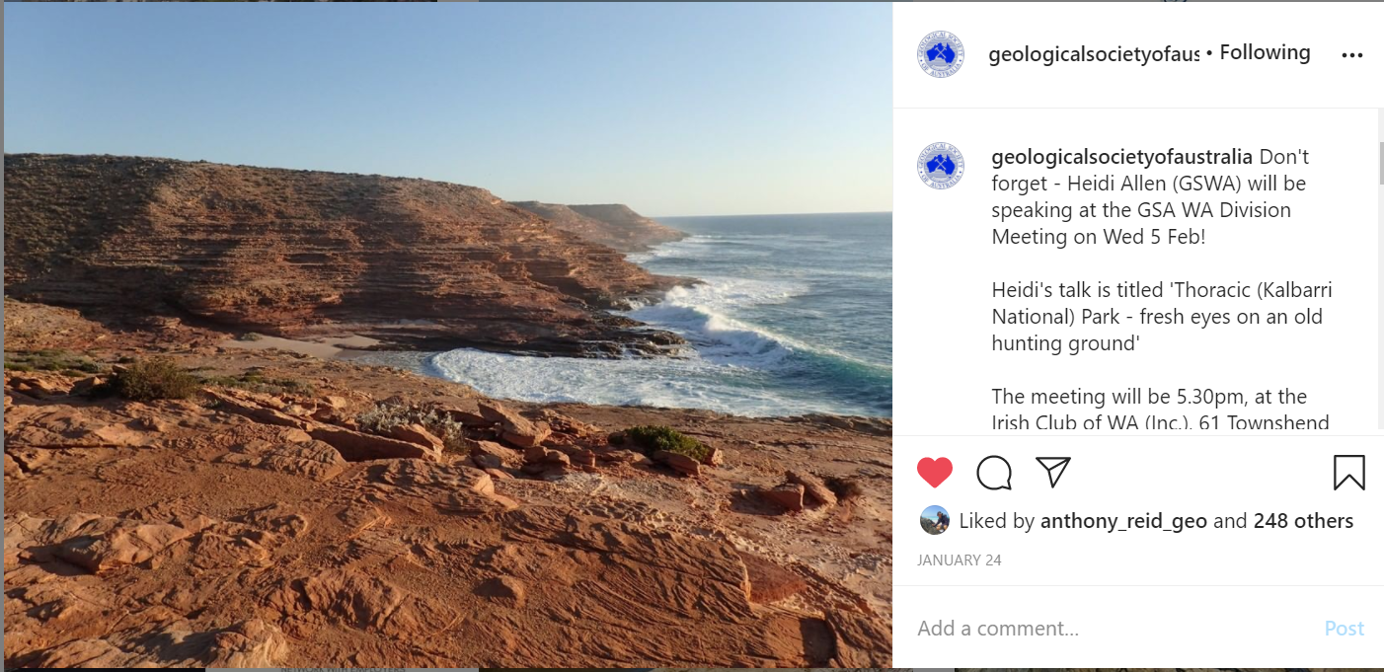
Benefits to Earth Scientists
Its highly visual – we work in some of the most beautiful and unique landscapes on Earth
A day in the life of …

Slide 25
is Facebook for professionals.
On LinkedIn you post your professional profile and apart from keeping in touch with other people in your field and building a network. LinkedIn puts you in an online space where others in your field, including prospective employers, know you exist and can see what your areas of expertise are
Advantages
Exclusively professional network
Huge potential audience
Effective at brand building
Ability to publish longer articles
Keep up network with former collegues
Fast growing – 2 new members every second
Usage in Australia (2019 stats)
8,000,000 users
28% male, 17% female
18-29 year olds largest age demographic (25%)
30-39 and 40-49 year olds close 2nd at 24%
Average LinkedIn user checks their feed around 10x a week

Slide 26
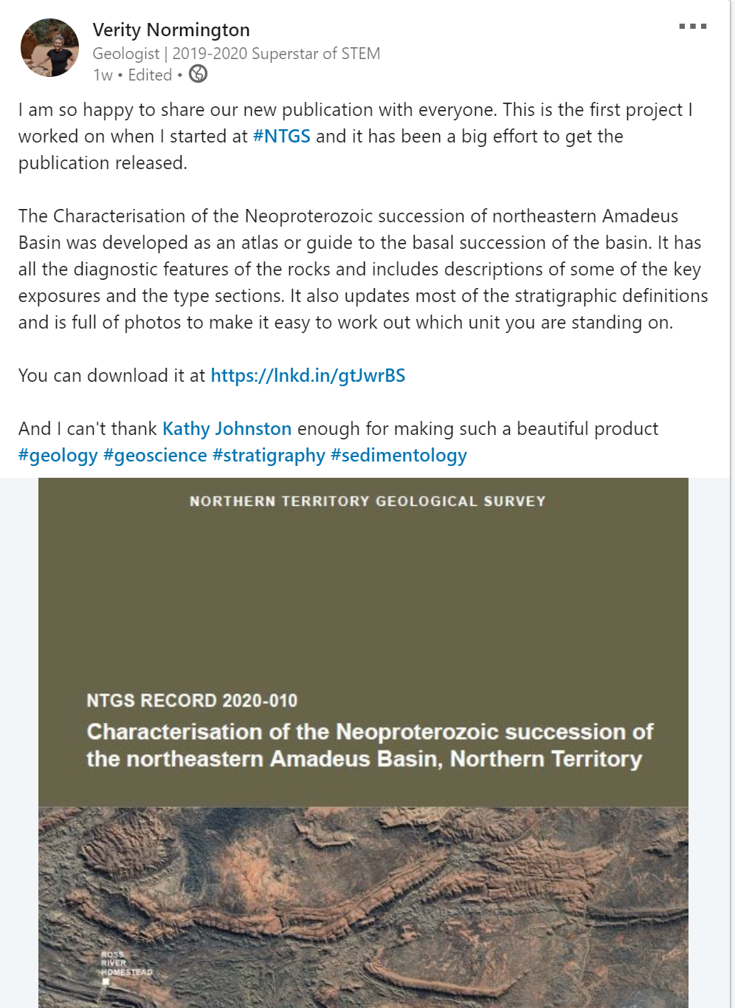
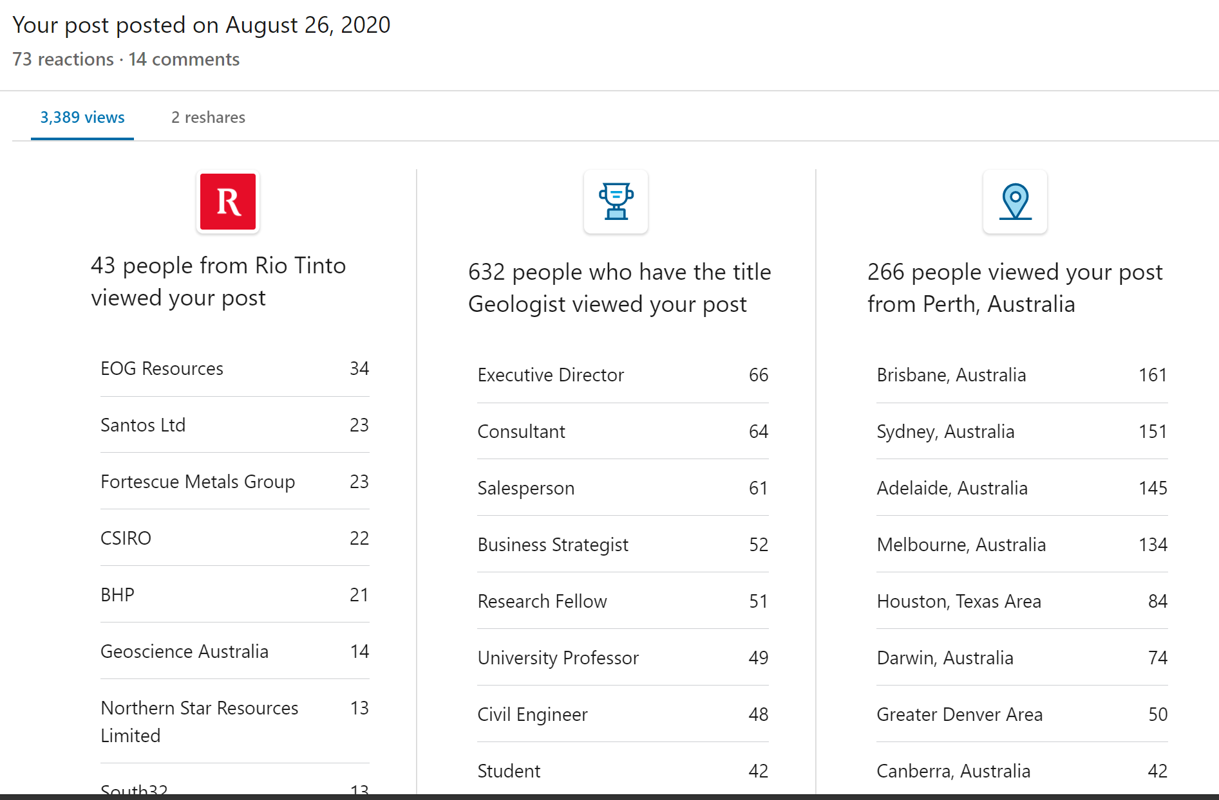
Using Effectively
Ensure your profile is up to date and complete
Be interactive; comment and reply
Every day or two post updates, like content, try and post longer form content on a weekly basis
Aim to spend about 90 minutes a week posting, interacting, commenting
Use content already developed for other media – presentations, publications etc
Reshare old content with a fresh take

Slide 27
Poll
Know that you know a bit more.
Do you use social media for Science Communication?
Yes
No
Still not Sure

Slide 28
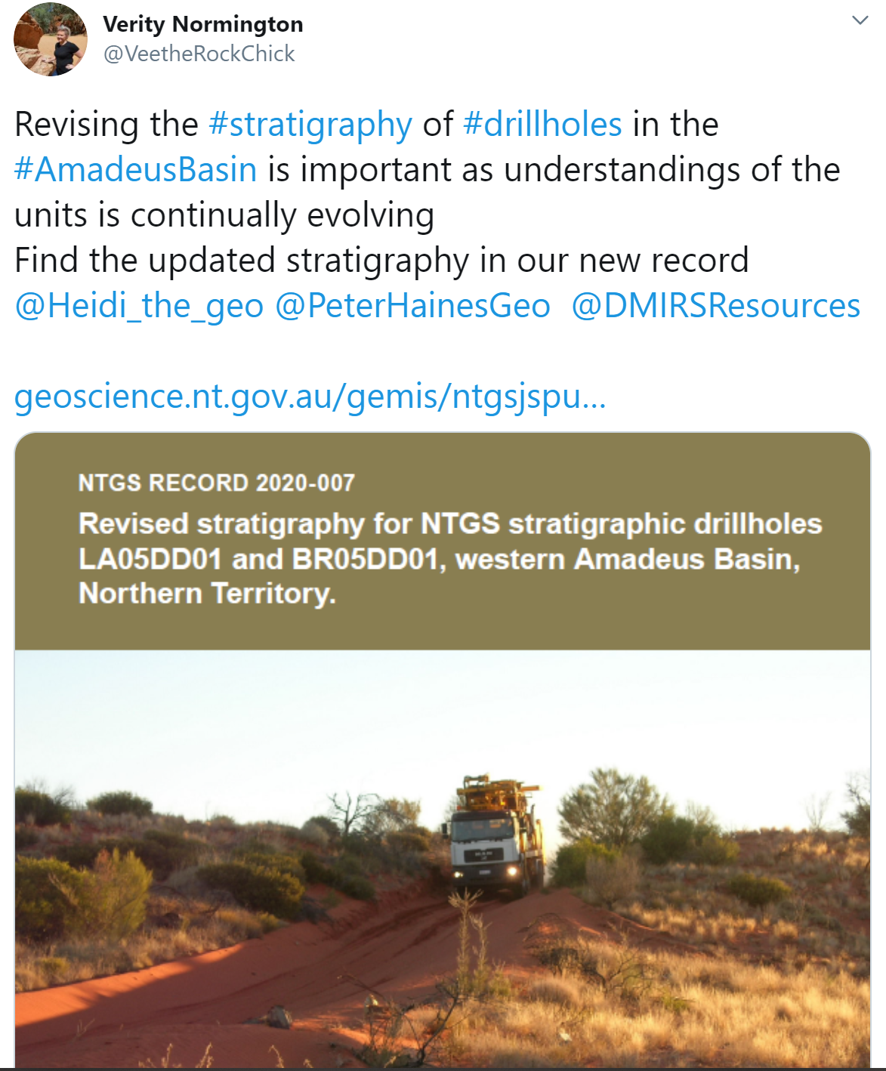
Composing a Post
Make it visual
Text – use a ‘hook’ - Highlight the important facts, findings or purpose that you audience will find interesting
Use #Hashtags
@Tag co-authors or collaborators

Slide 29
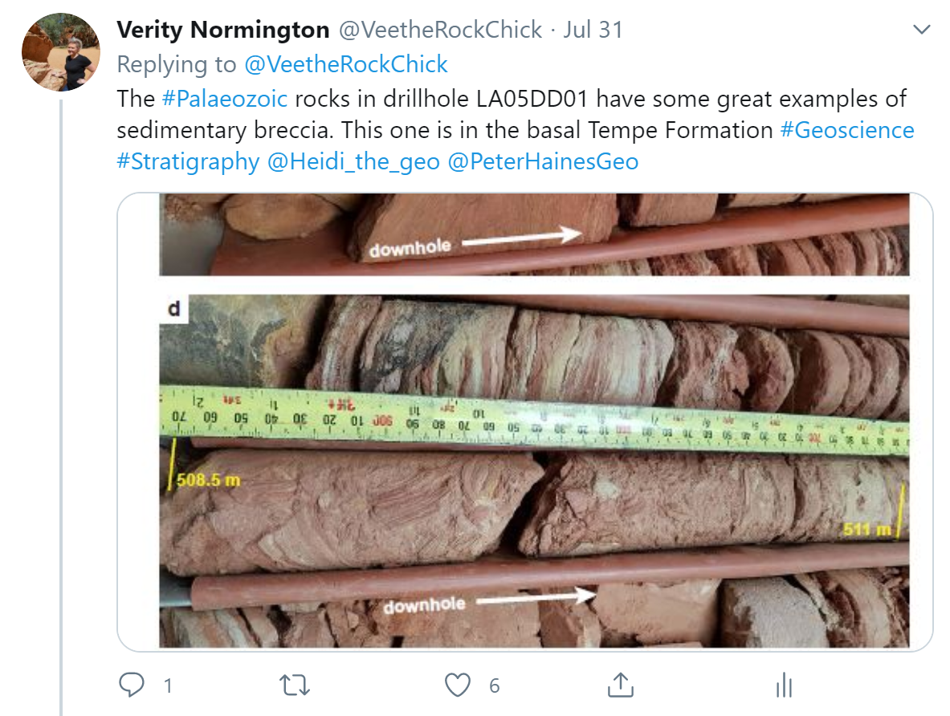
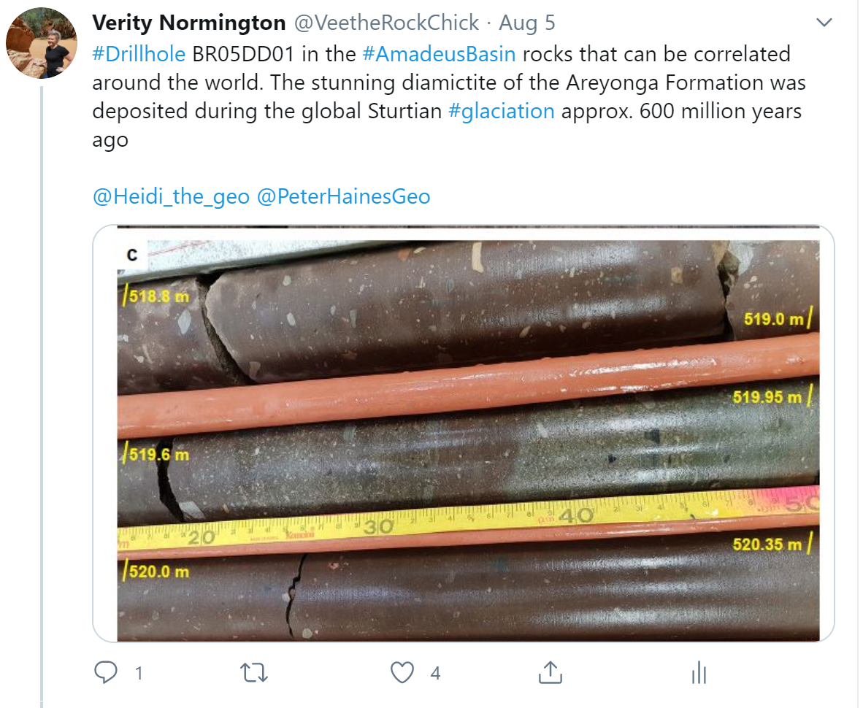
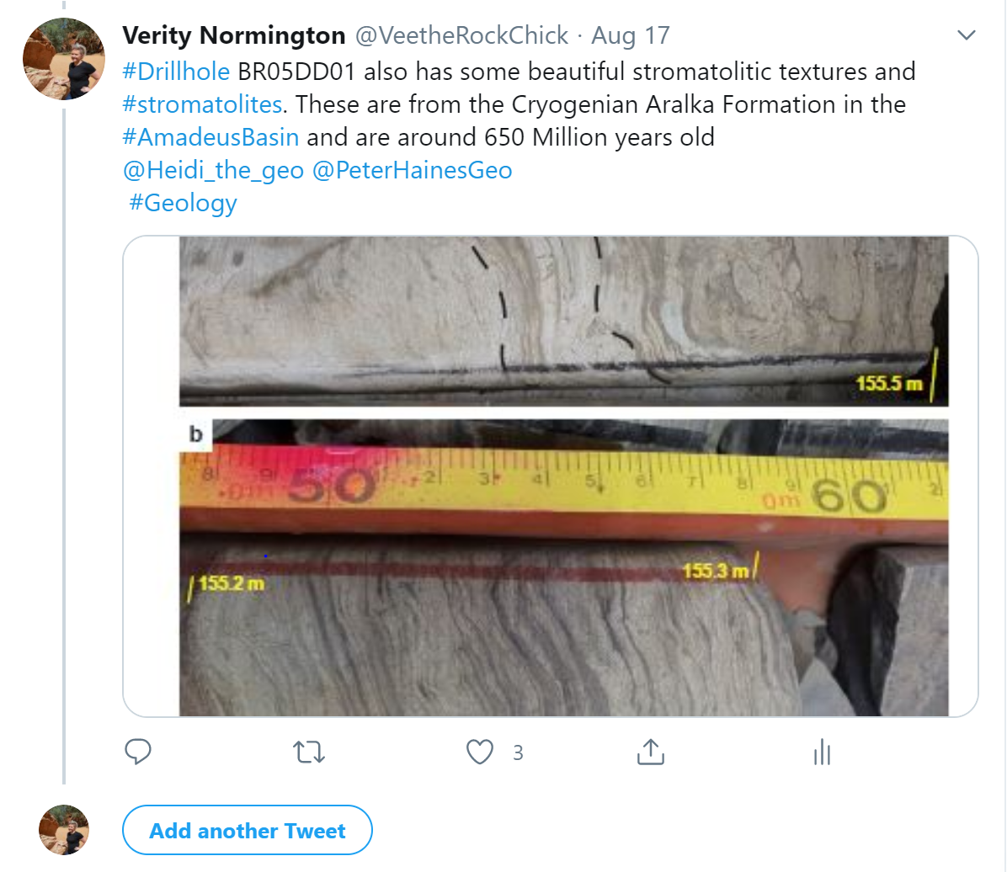
Advertising publications
Use the retweet or reply function to continue the conversation over time
Mix up the #hashtags but keep the most important one
Use new images to highlight something different each time

Slide 30
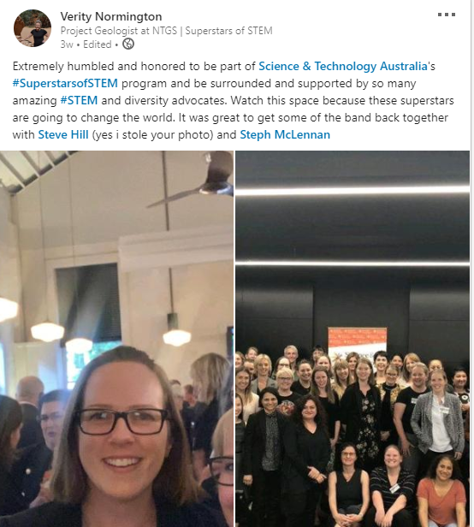
Advertising events – presentations, webinars etc
This is a great way to generate interest in the things you are involved in. It also raises your public profile.
Use the #hashtags of the event
@tag others you are collaborating with or you know is also attending
Remember to link the registration page

Slide 31
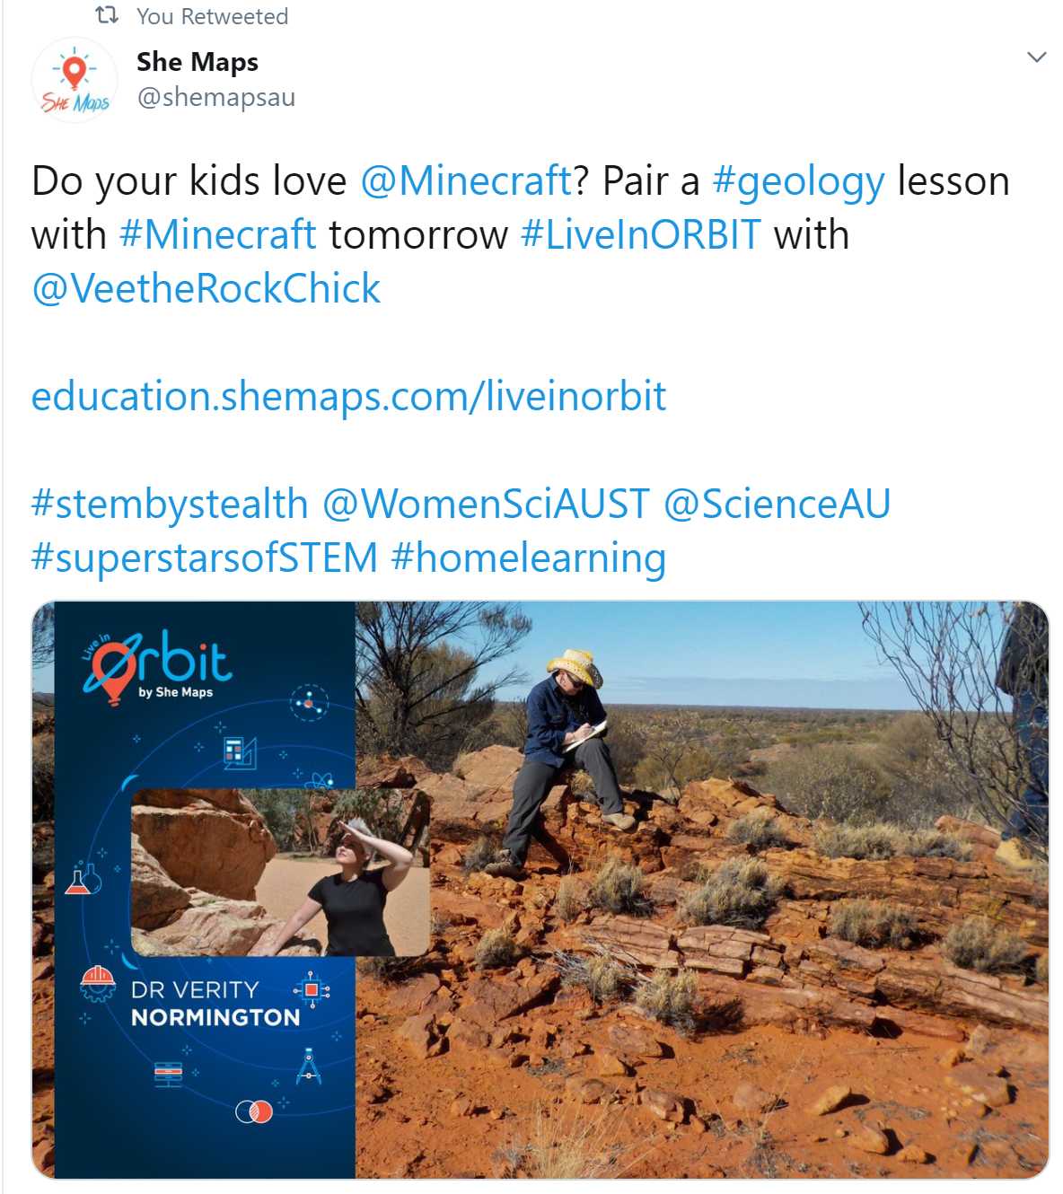
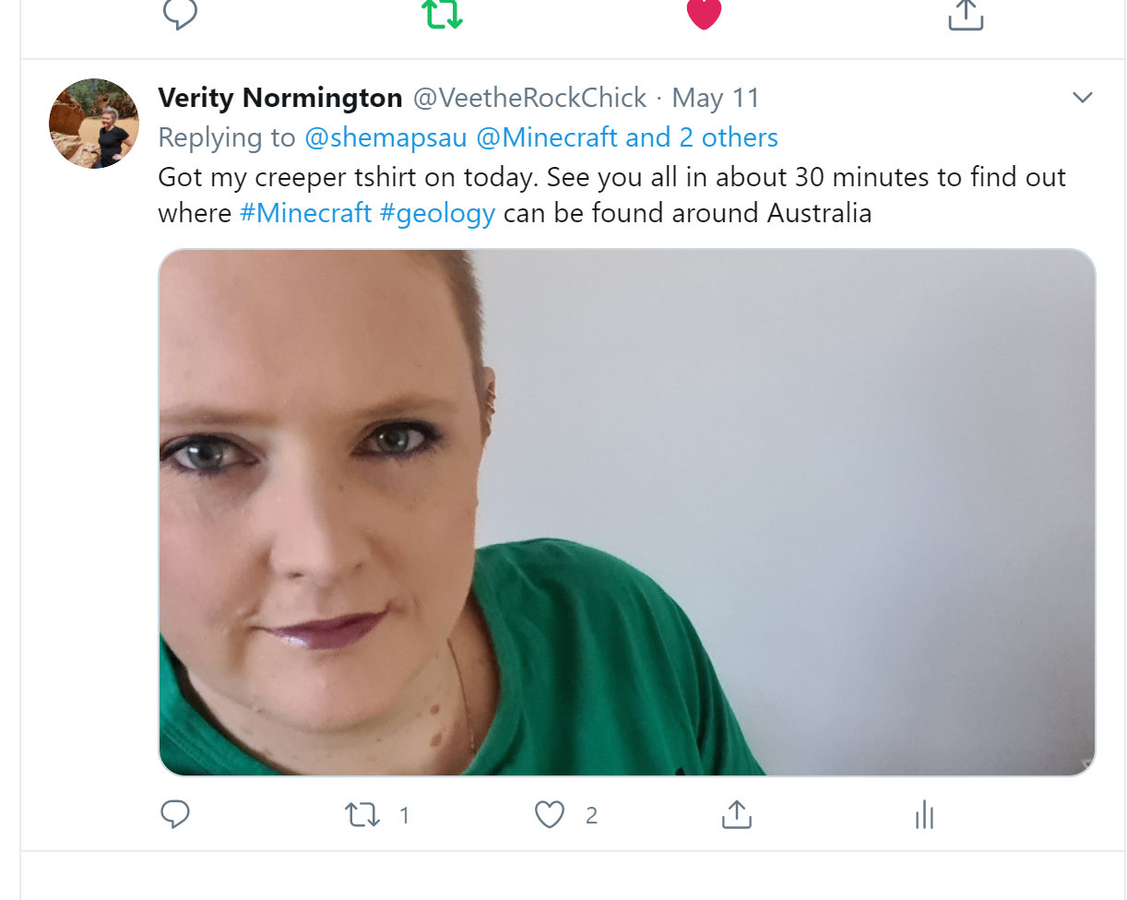
Advertising events – presentations, webinars etc
This is a great way to generate interest in the things you are involved in. It also raises your public profile.
Use the #hashtags of the event
@tag others you are collaborating with or you know is also attending
Remember to link to the registration page

Slide 32
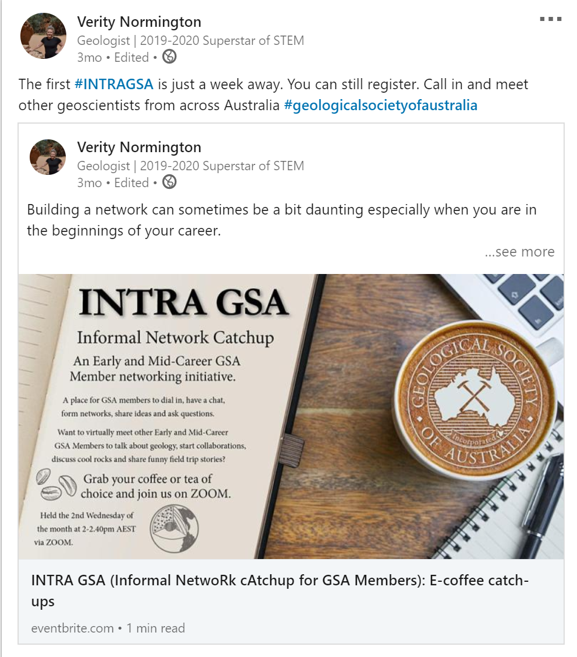
Advertising events – presentations, webinars etc
This is a great way to generate interest in the things you are involved in. It also raises your public profile.
Use the #hashtags of the event
@tag others you are collaborating with or you know is also attending
Remember to link the registration page

Slide 33
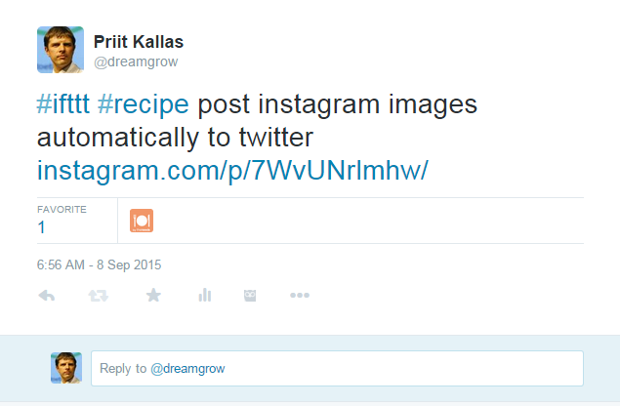
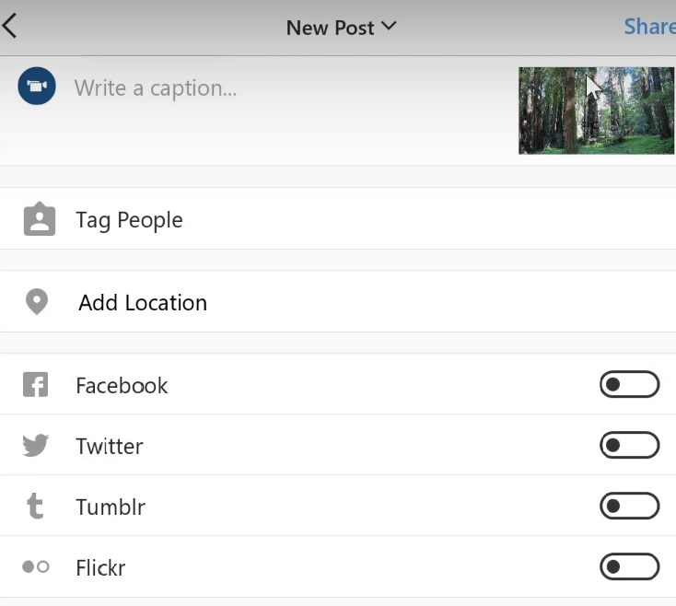
Native posting
Native posting is when you post directly into a platform.
Most platforms will prioritise these posts in their feeds over 3rd party posts.
While 3rd party apps are a time saver, sometimes the post isn’t formatted for maximum impact
Instagram has an ‘also post to’ function

Slide 34
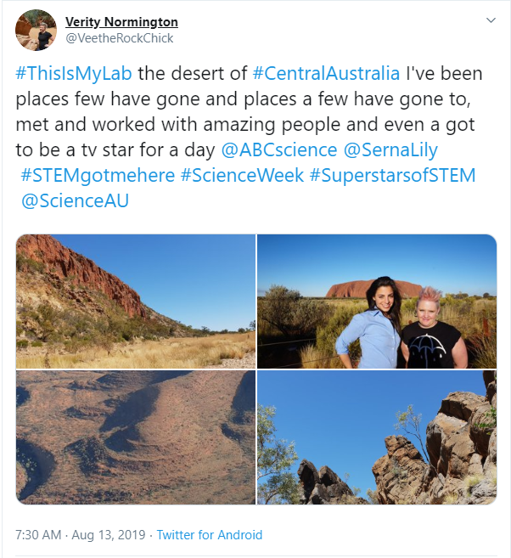
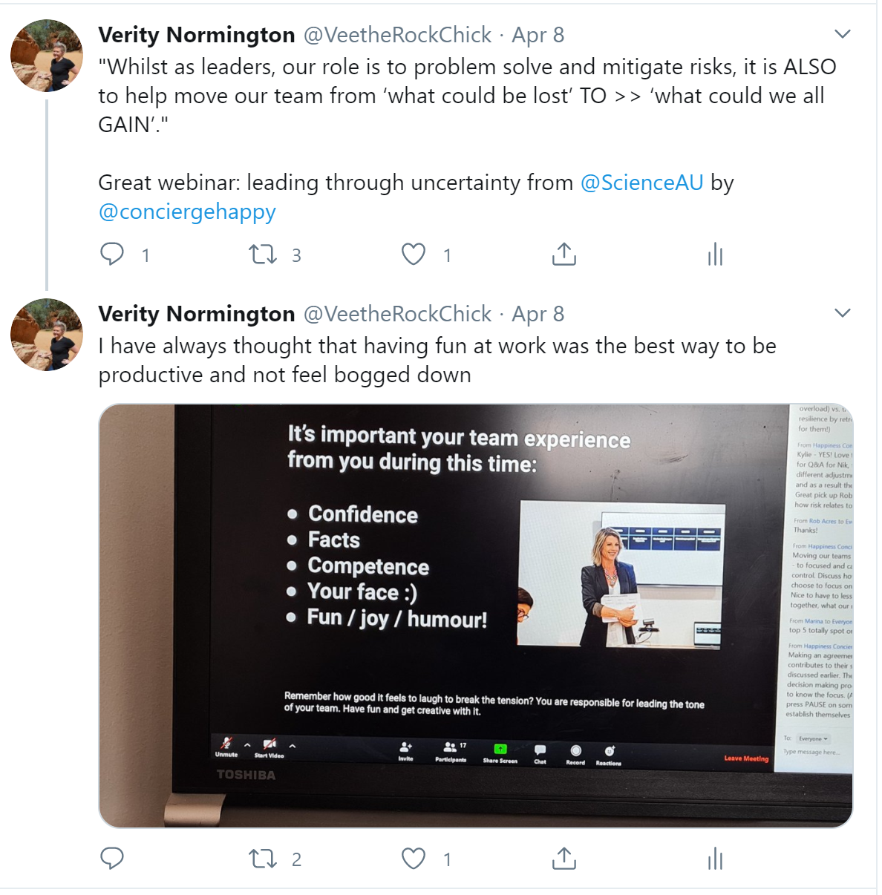
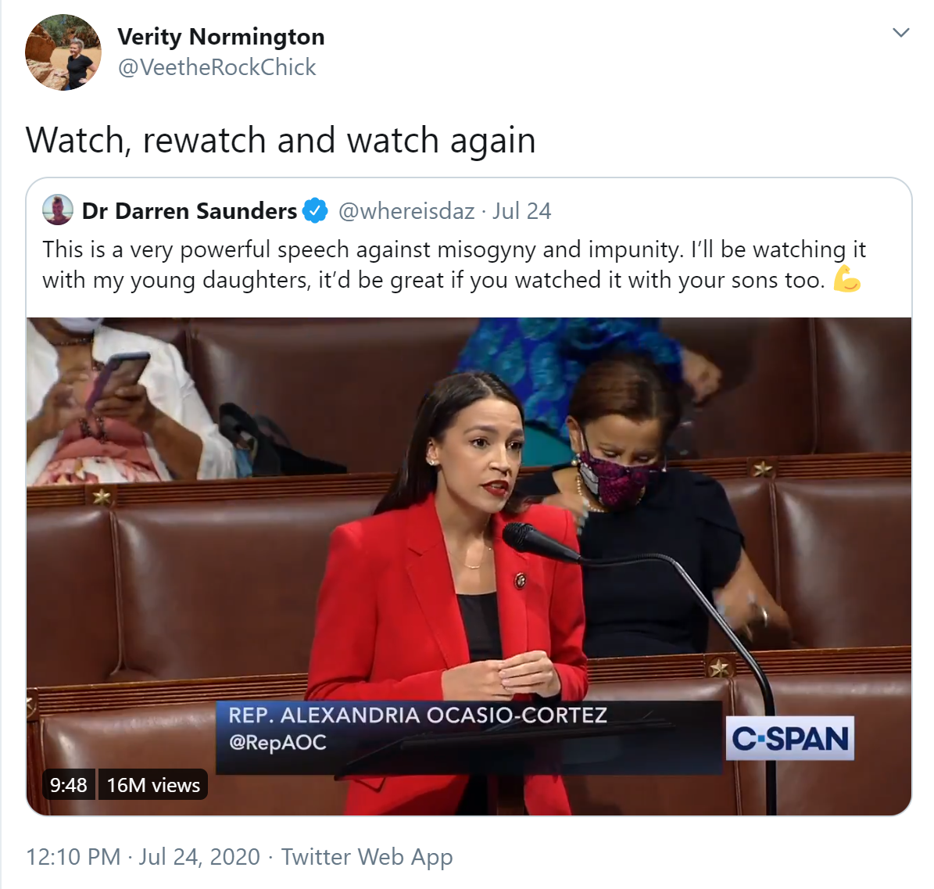
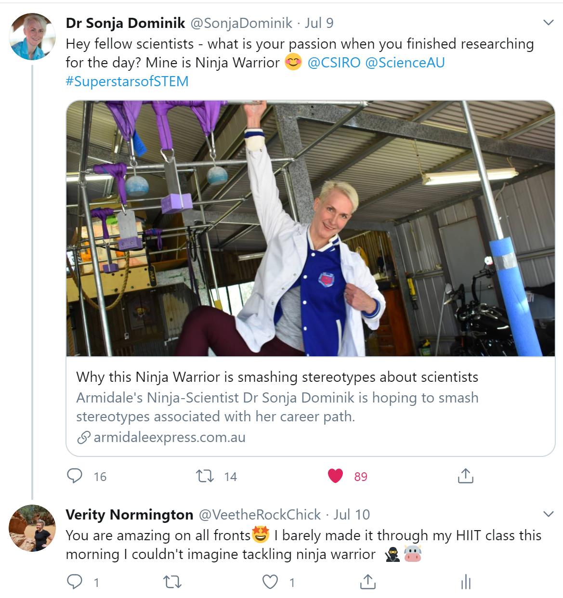
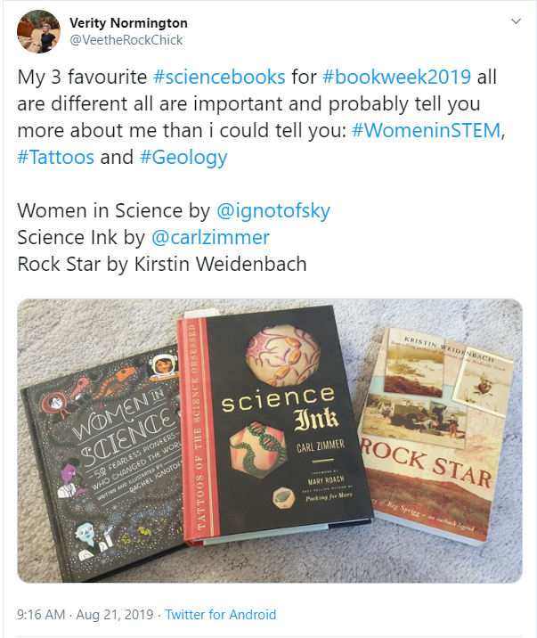
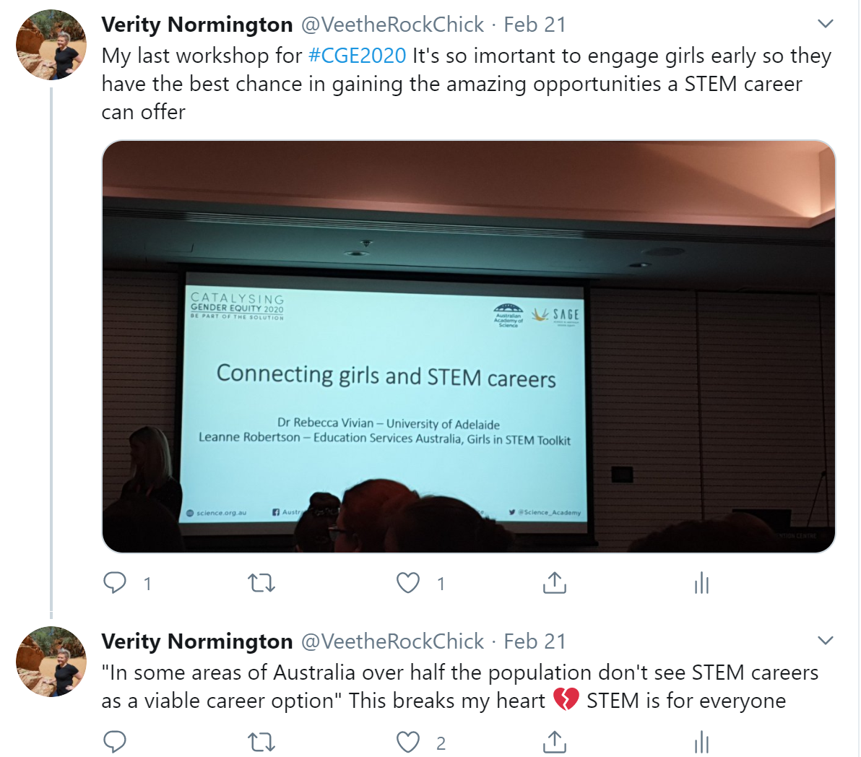
Finding content
Participate in events #Science Week
Follow across disciplines and industries – comment and reshare
Live tweet using #hashtags

Slide 35
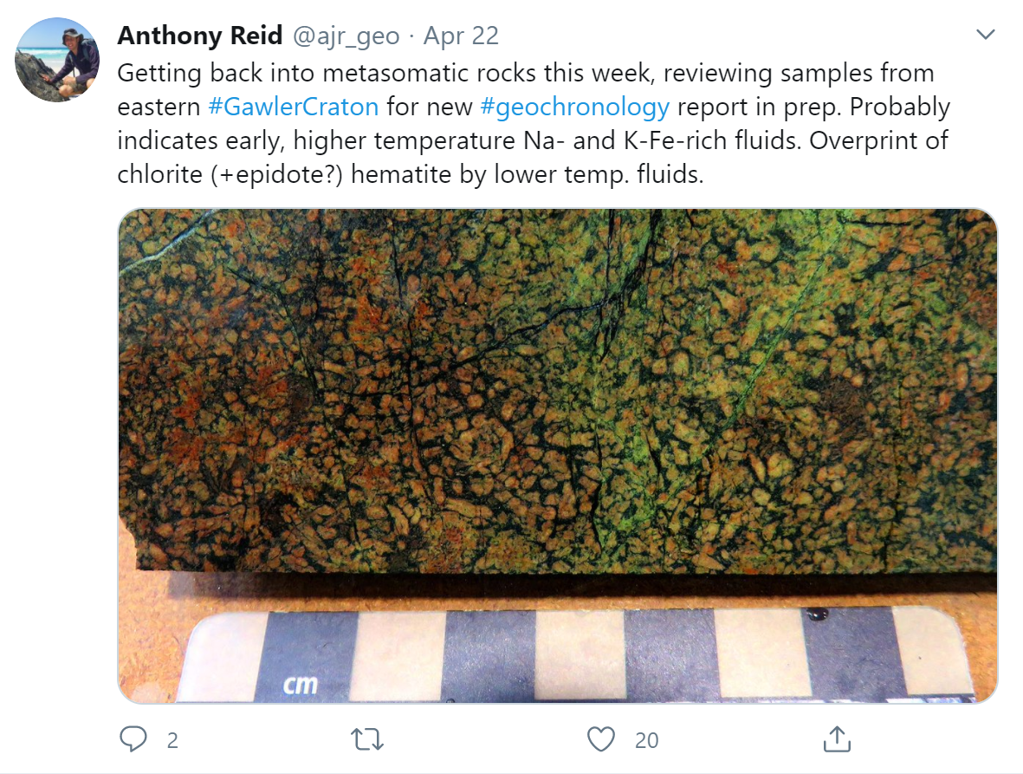
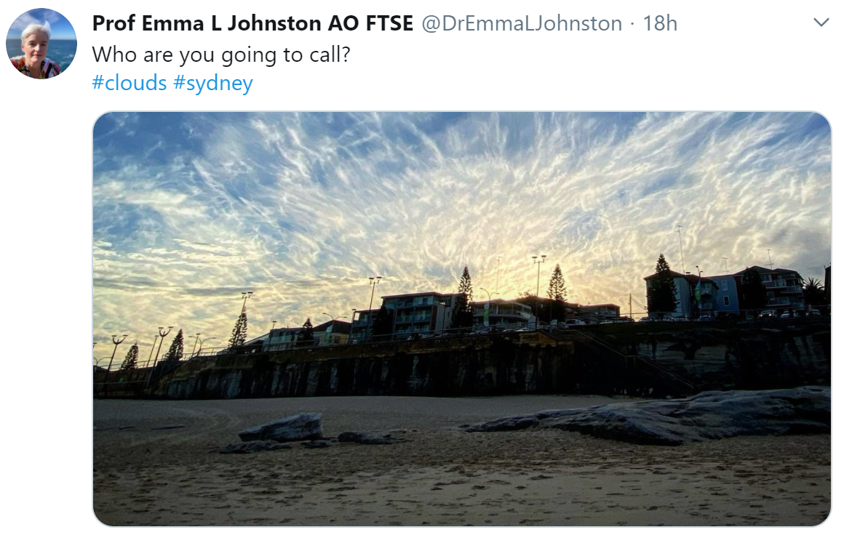
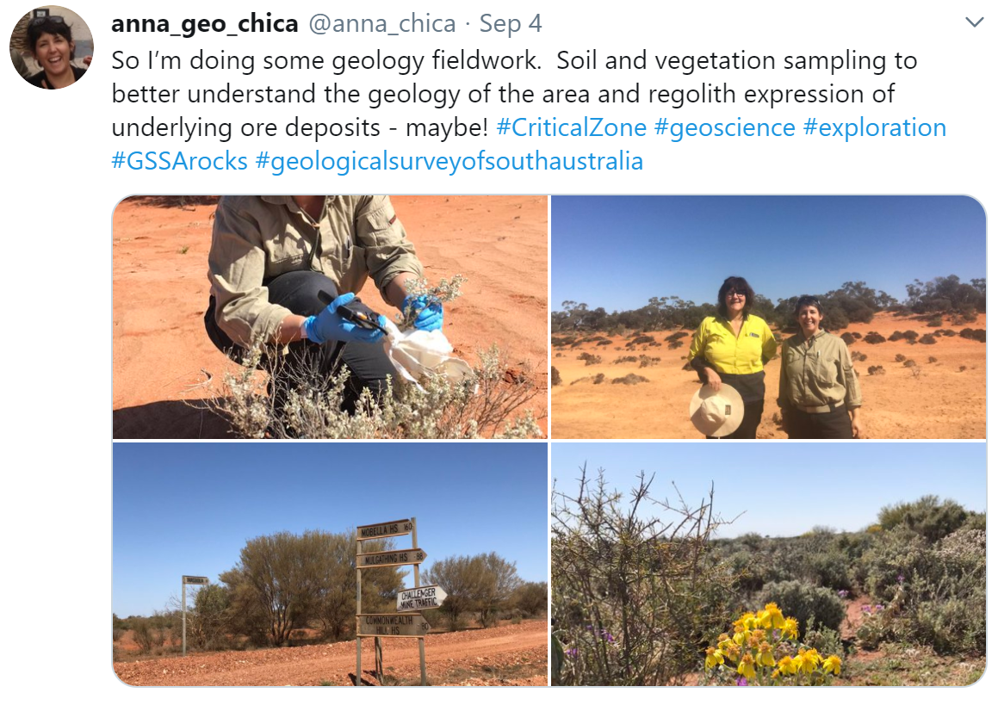
Plan ahead
Be opportunistic
Use the save draft function
Add posting to your to do list or schedule time in your calender
Remember you only need 5 minutes to post something

